Slide 1
Title
IMPROVING IMAGING BY USING
GENETIC ALGORITHMS TO FIND
ARBITRARY PROFILES OF
BESSEL BEAM LASER by
Leon Hunter
Project Advisors
Dr. Tomasz Smolinski
Dr. Thomas Planchon

Slide 2
Overview
Background
Objective of Project
Determining a Good Solution
Methodology
Approach
Reproduction
Results
Conclusion
Future Work

Slide 3
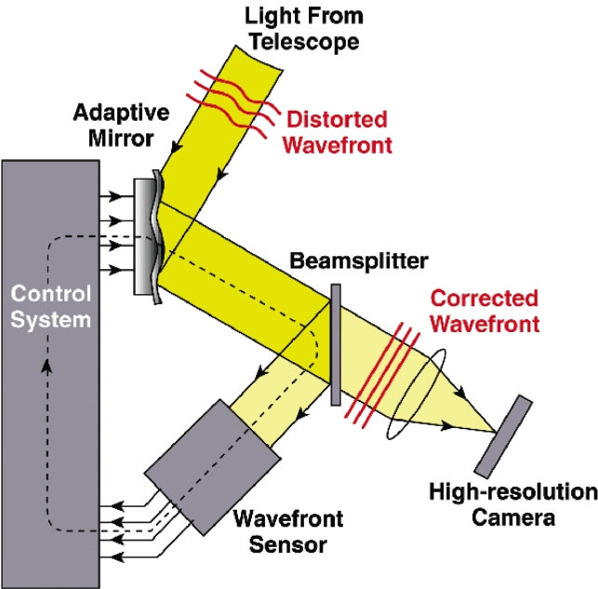
Adaptive Optics
Process to enhance the performance of an optical system
  Reduces effect of wave front distortions using active optic
Active optics is an optical instrument with an adjustable reflective component
- i.e. – Corrective Lens
Notes:
Adaptive - Process used to better the results yielded by whatever method is being executed
Active – Device that morphs reflective surface to prevent deformity

Slide 4
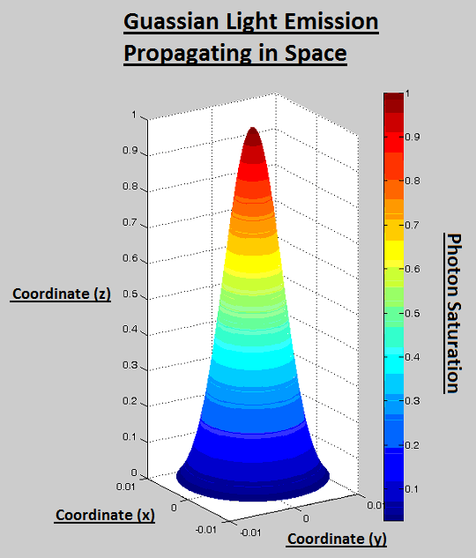
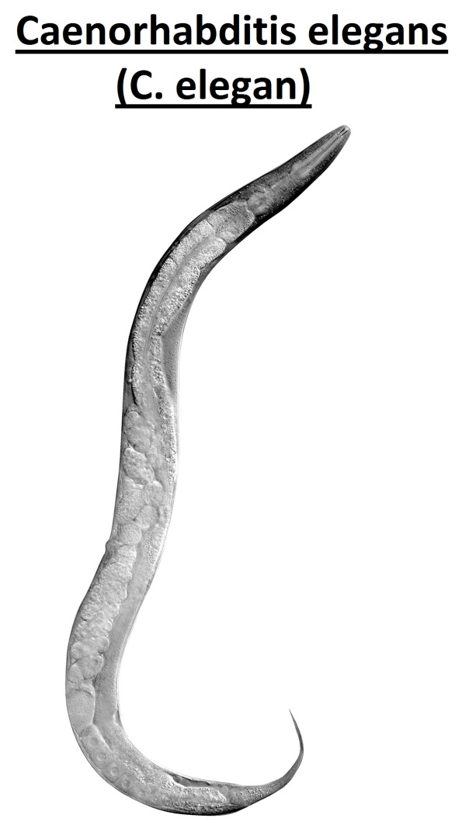
Background

Slide 5
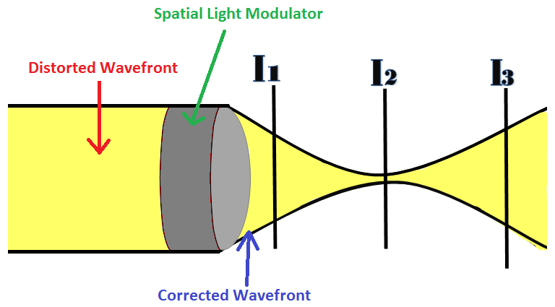
Objective

Slide 6


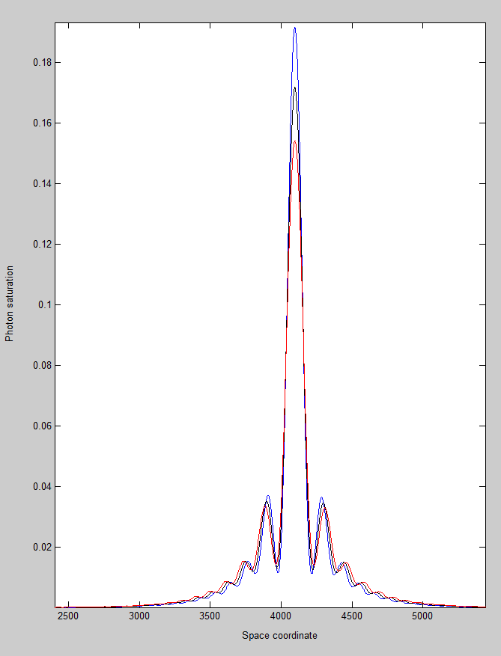
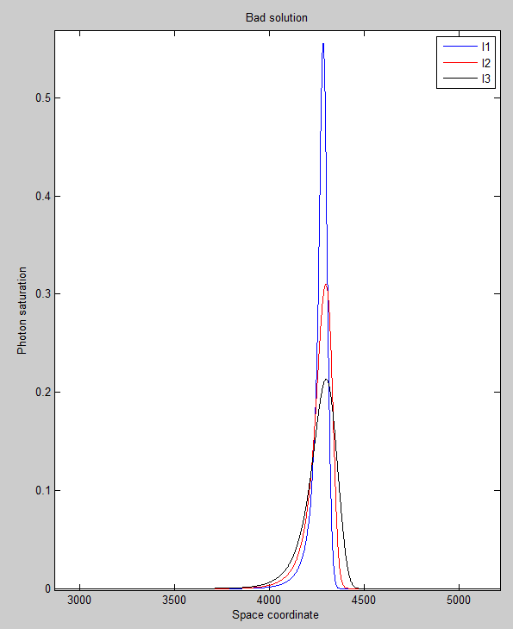

Determining Good Solutions

Slide 7
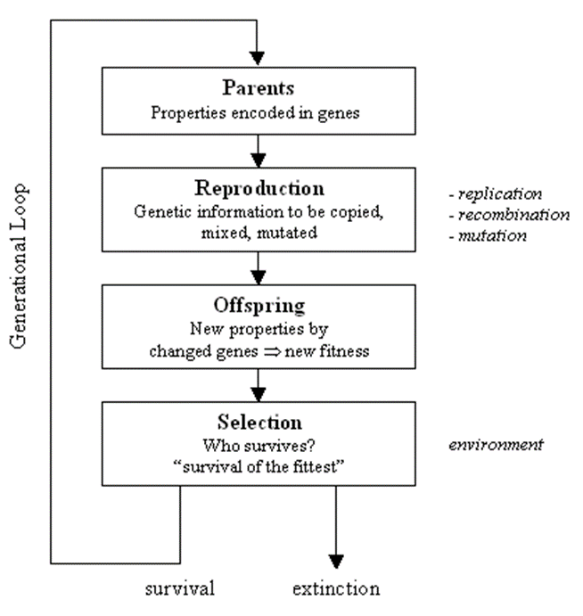
Genetic Algorithm
10 different phase functions ϕ(x,y)
- Each phase function (parent) will be sent to SLM
  Makings of Genetic Algorithms include parents¹, reproduction², offspring³, and selection⁴.
    1. Parents - contain properties (DNA) to be reproduced and passed to offspring who may or may not survive depending on fitness for environment.
    2. Reproduction – process of parents’ genetic information being copied, mixed, and mutated.
    3. Offspring - resulting entities whose properties are yielded by reproduction
    4. Selection - actions to decide which offspring is most suited for parenting.
**Note: Evolution of the contending solution(s) occurs over many generations.
Notes:
• Optimization of active optics controlled by genetic algorithms
• Genetic algorithms - type of optimization algorithm that grades potential solutions based on fitness and ability to survive in environment.
• Fitness function - the environment entities are being tested against.

Slide 8
Approach
Technique | Toolbox | Custom Mutation | Symmetry Imposed
A | no | no | yes
B | no | no | no
A0 | yes | no | yes
A1 | yes | yes | yes
B0 | yes | no | no
B1 | yes | yes | no

Slide 9
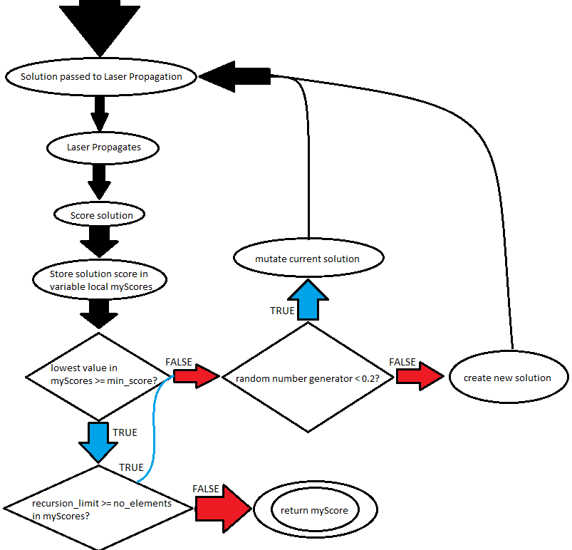
Custom Mutations

Slide 10
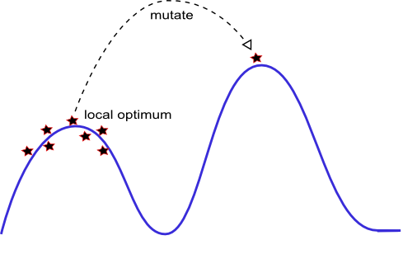
Local Optima

Slide 11
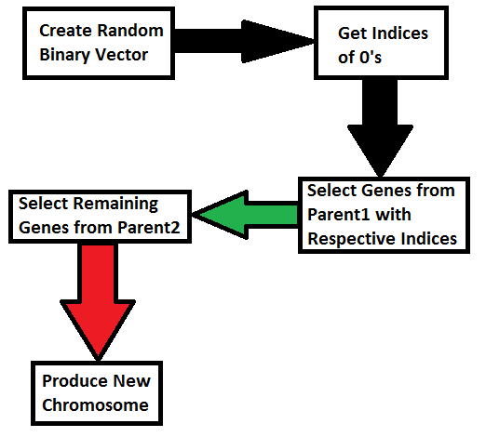
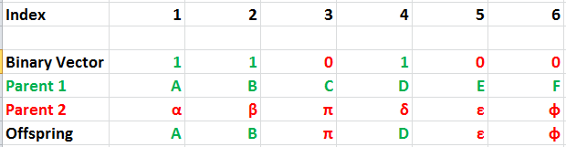
Reproduction
Crossover function describes how genetic information is mixed between parents

Slide 12
Results
Technique A
 | Trial | Min | Max | Average | Generations | Time
 | 1 | 2.4797 | 100 | 31.7926 | 25 | 2.6109
 | 2 | 1.9334 | 100 | 27.5218 | 50 | 4.2567
 | 3 | 1.6514 | 100 | 26.9806 | 75 | 6.3695
 | 4 | 1.2419 | 100 | 25.7951 | 100 | 8.6315
 | 5 | 1.1885 | 100 | 25.7734 | 125 | 10.8114
 | 6 | 0.7134 | 100 | 25.2715 | 150 | 12.9762
 | 7 | 1.0372 | 100 | 25.8997 | 175 | 15.0732
 | 8 | 0.7638 | 100 | 25.1863 | 200 | 17.0704
 | 9 | 0.8813 | 100 | 25.433 | 225 | 19.389
Average |  | 1.3212 | 100 | 26.62822222 | 125 | 10.7988
Technique B
 | Trial | Min | Max | Average | Generations | Time
 | 1 | 3.2392 | 100 | 31.2922 | 25 | 2.1514
 | 2 | 2.2396 | 100 | 29.1991 | 50 | 4.3428
 | 3 | 1.6779 | 100 | 27.7104 | 75 | 6.4864
 | 4 | 1.2932 | 100 | 25.4516 | 100 | 8.6214
 | 5 | 1.2706 | 100 | 26.3621 | 125 | 10.7345
 | 6 | 0.7535 | 100 | 25.4742 | 150 | 12.6401
 | 7 | 0.5646 | 100 | 24.8328 | 175 | 15.1333
 | 8 | 0.6197 | 100 | 25.5518 | 200 | 16.8736
 | 9 | 0.7447 | 100 | 24.5157 | 225 | 19.0277
Average |  | 1.37811111 | 100 | 26.7099888 | 125 | 10.6679111

Slide 13
Results

Slide 14
Conclusion; no toolbox
The no toolbox projects are very capable of producing viable solutions. However, their scoring methods are fallible.
If the minimum intensity of a plane is less then 0.2, then it is given the score of 100.
This causes the calculated mean values to become inflated, making it difficult to identify why the values are so large on average without background on the internal mechanics of the fitness.
Instead, the method for evaluating fitness should be normalized.

Slide 15
Conclusion; toolbox

Slide 16
Future Work; Interface Algorithm to SLM
Control spatial light modulator (SLM) used for shaping profile of laser beam
Measure result of shaping with 2D camera.
Spatial light modulator – device used to modulate amplitude, phase, or polarization of light waves in space and time.
Apply solution to various fields of science who are faced with similar issues that can be solved by correcting wave front distortions.
Notes:
i.e. - hydrodynamics, acoustics

Slide 17
Future Work

Slide 18
Thank you!
Questions?

